Slide 1
Operating System
Lecture #3
Introduction to OS

Slide 2
Objectives
To get familiar with popular OS like Unix, Linux and Windows.
Understand the structure of OS.
Types of OS
Evolution of OS
System Calls

Slide 3
OS Structure
The approach of interconnecting and integrating multiple operating system components into the kernel can be described as an operating system structure.
Simple Structure
Monolithic Structure
Layered Approach
Micro-kernel

Slide 4
Simple Structure
It is the simplest Operating System Structure and is not well defined; It can only be used for small and limited systems. In this structure, the interfaces and levels of functionality are well separated; hence programs can access I/O routines which can cause unauthorized access to I/O routines.
If one user program fails, the entire operating system gets crashed.
The abstraction level in MS-DOS systems is low, so programs and I/O routines are visible to the end-user, so the user can have unauthorized access.

Slide 5
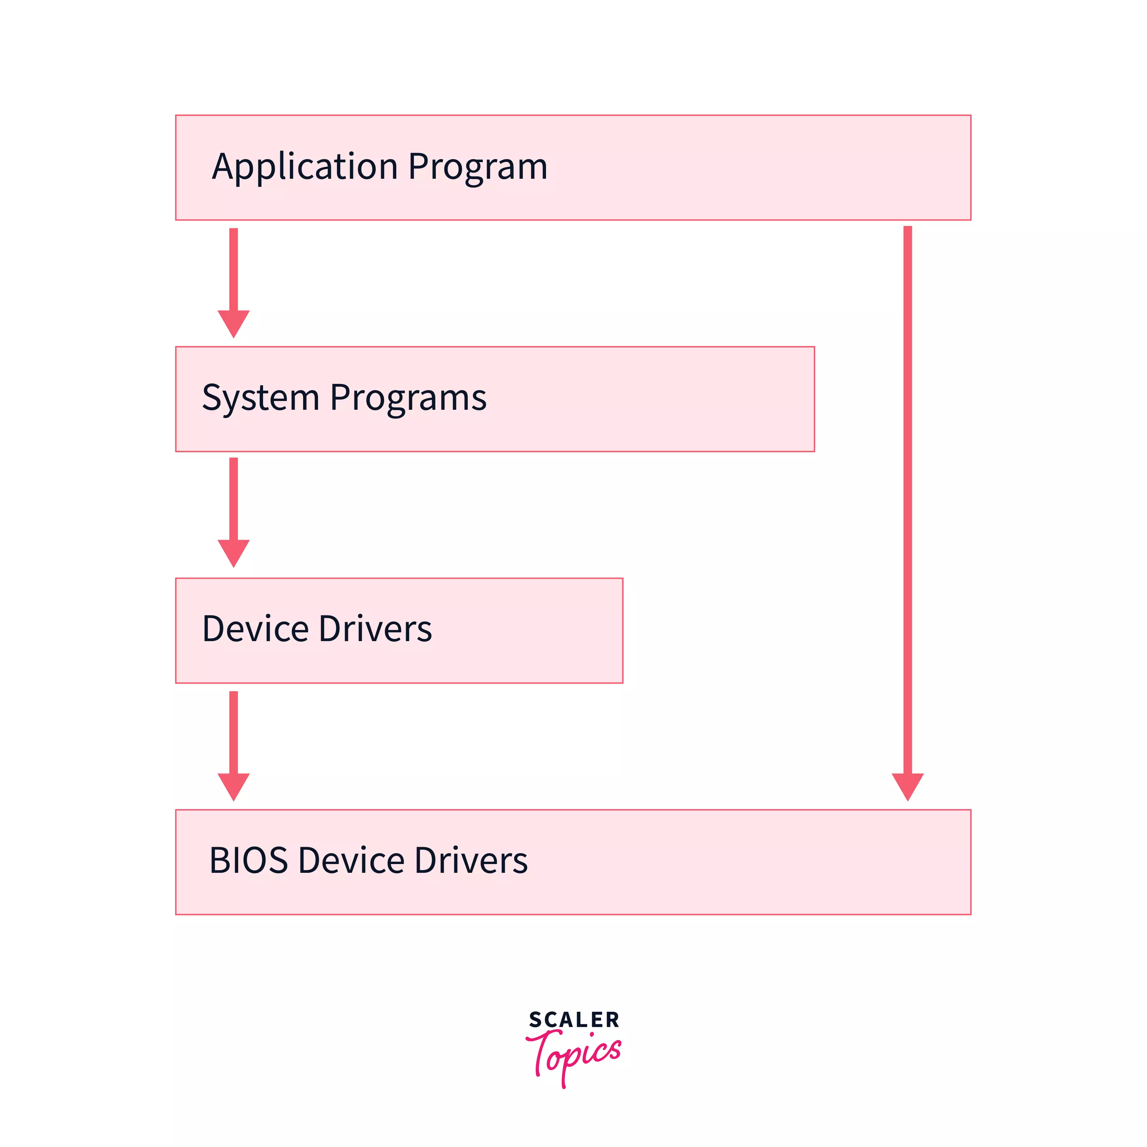
Simple Structure

Slide 6
Advantages and Disadvantages
Advantages of Simple Structure
It is easy to develop because of the limited number of interfaces and layers.
Offers good performance due to lesser layers between hardware and applications.
Disadvantages of Simple Structure
If one user program fails, the entire operating system crashes.
Abstraction or data hiding is not present as layers are connected and communicate with each other.
Layers can access the processes going in the Operating System, which can lead to data modification and can cause Operating System to crash.

Slide 7
Monolithic Structure
The Monolithic operating System in which the kernel acts as a manager by managing all things like file management, memory management, device management, and operational processes of the Operating System.
The kernel is the heart of a computer operating system (OS). Kernel delivers basic services to all other elements of the System. It serves as the primary interface between the Operating System and the hardware.
In monolithic systems, kernels can directly access all the resources of the operating System like physical hardware, exp Keyboard, Mouse etc.

Slide 8
Monolithic Structure
The monolithic kernel functions as a virtual machine by working on top of the Operating System and controlling all hardware components. This is an outdated operating system that was used in banks to accomplish minor activities such as batch processing and time-sharing, which enables many people at various terminals to access the Operating System.

Slide 9
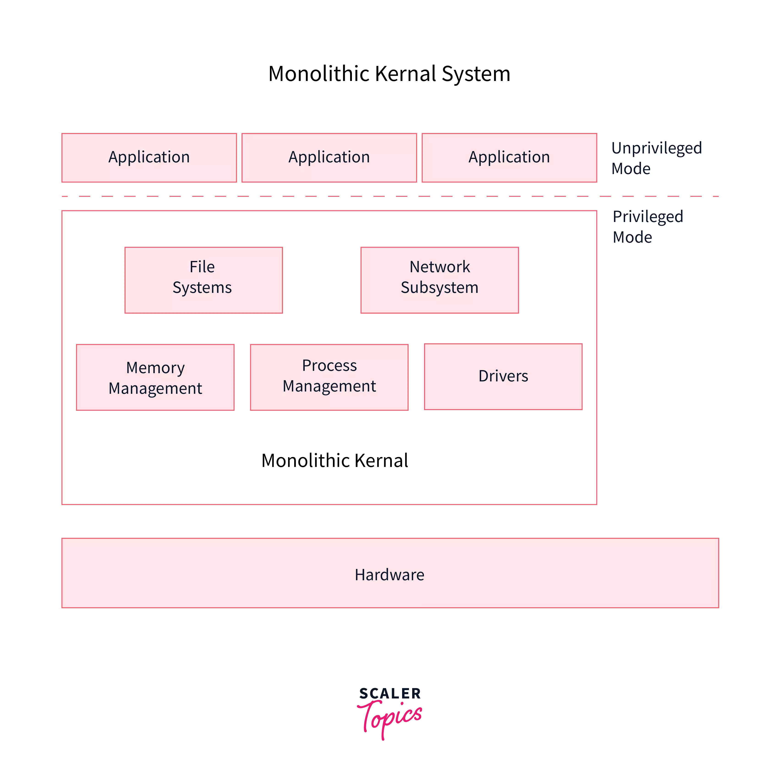

Slide 10
Advantages and Disadvantages
Advantages of Monolithic structure:
It is simple to design and implement because all operations are managed by kernel only, and layering is not needed.
As services such as memory management, file management, process scheduling, etc., are implemented in the same address space, the execution of the monolithic kernel is relatively fast as compared to normal systems. Using the same address saves time for address allocation for new processes and makes it faster.
Disadvantages of Monolithic structure:
If any service in the monolithic kernel fails, the entire System fails because, in address space, the services are connected to each other and affect each other.
It is not flexible, and to introduce a new service

Slide 11
Layered Approach
In this type of structure, OS is divided into layers or levels. The hardware is on the bottom layer (layer 0), while the user interface is on the top layer (layer N). These layers are arranged in a hierarchical way in which the top-level layers use the functionalities of their lower-level levels.
In this approach, functionalities of each layer are isolated, and abstraction is also available. In layered structure, debugging is easier as it is a hierarchical model, so all lower-level layered is debugged, and then the upper layer is checked. So all the lower layers are already checked, and the current layer is to be checked only.

Slide 12
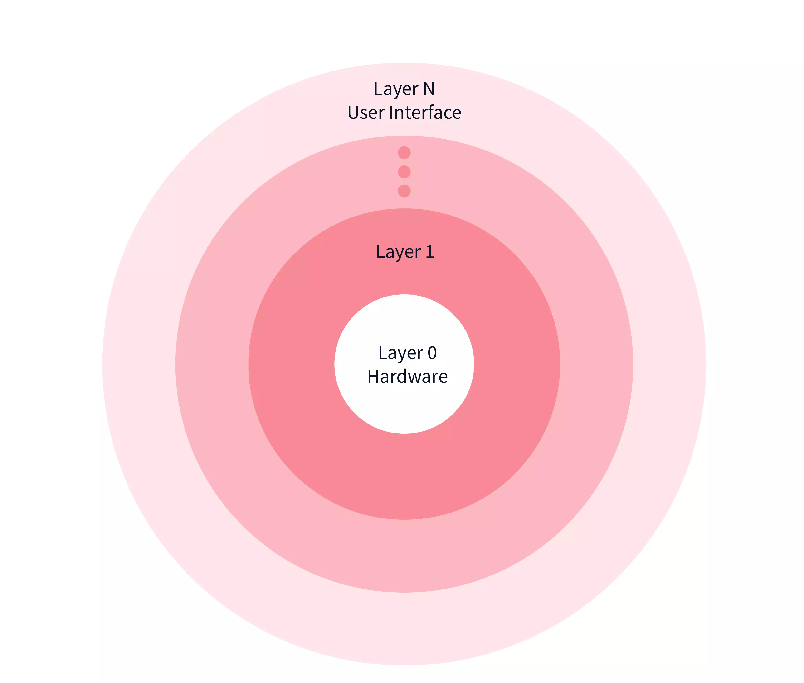

Slide 13
Advantages and Disadvantages
Advantages of Layered Structure
Each layer has its functionalities, so work tasks are isolated, and abstraction is present up to some level.
Debugging is easier as lower layers are debugged, and then upper layers are checked.
Disadvantages of Layered Structure
In Layered Structure, layering causes degradation in performance.
It takes careful planning to construct the layers since higher layers only utilize the functions of lower layers.

Slide 14
Micro-kernel
Micro-Kernel structure designs the Operating System by removing all non-essential components of the kernel. These non-essential components of kernels are implemented as systems and user programs. Hence these implemented systems are called as Micro-Kernels.
Each Micro-Kernel is made independently and is isolated from other Micro-Kernels. So this makes the system more secure and reliable. If any Micro-Kernel fails, then the remaining operating System remains untouched and works fine.

Slide 15
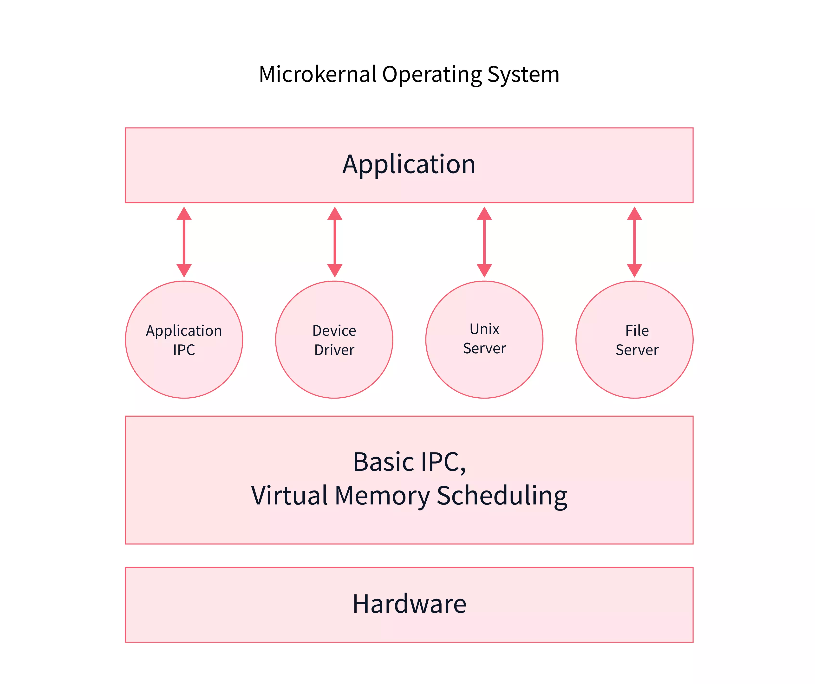
Micro-kernel

Slide 16
Advantages and Disadvantages
Advantages of Micro-kernel structure:
It allows the operating system to be portable between platforms.
As each Micro-Kernel is isolated, it is safe and trustworthy.
Because Micro-Kernels are smaller, they can be successfully tested.
If any component or Micro-Kernel fails, the remaining operating System is unaffected and continues to function normally.
Disadvantages of Micro-kernel structure:
Increased inter-module communication reduces system performance.
System is complex to be constructed.

Slide 17
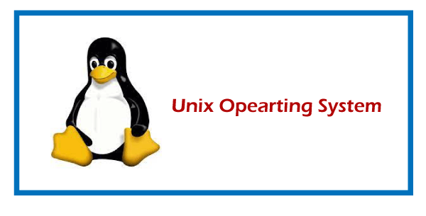
UNIX OS
UNIX is a powerful Operating System initially developed by Ken Thompson, Dennis Ritchie at AT&T Bell laboratories in 1970. It is prevalent among scientific, engineering, and academic institutions due to its most appreciative features like multitasking, flexibility, and many more. In UNIX, the file system is a hierarchical structure of files and directories where users can store and retrieve information using the files.

Slide 18
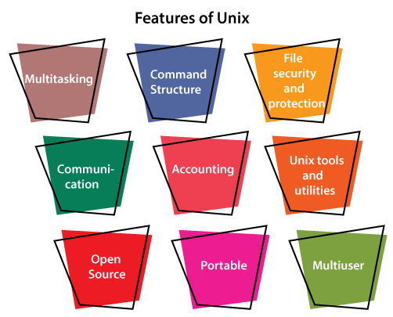

Slide 19
Features of UNIX OS
Multitasking: A UNIX operating system is a multitasking operating system that allows you to initiate more than one task from the same terminal so that one task is performed as a foreground and the other task as a background process.
Multi-user: UNIX operating system supports more than one user to access computer resources like main memory, hard disk, tape drives, etc. Multiple users can log on to the system from different terminals and run different jobs that share the resources of a command terminal. It deals with the principle of time-sharing. Time-sharing is done by a scheduler that divides the CPU time into several segments also called a time slice, and each segment is assigned to each user on a scheduled basis. This time slice is tiny. When this time is expired, it passes control to the following user on the system. Each user executes their set of instructions within their time slice.

Slide 20
Features of UNIX OS
Portability: This feature makes the UNIX work on different machines and platforms with the easy transfer of code to any computer system. Since a significant portion of UNIX is written in C language, and only a tiny portion is coded in assembly language for specific hardware.
File Security and Protection: Being a multi-user system, UNIX makes special consideration for file and system security. UNIX has different levels of security using assigning username and password to individual users ensuring the authentication, at the level providing file access permission viz. read, write and execute and lastly file encryption to change the file into an unreadable format.
Command Structure: UNIX commands are easy to understand and simple to use. Example: "cp", mv etc. While working in the UNIX environment, the UNIX commands are case-sensitive and are entered in lower case.
Communication: In UNIX, communication is an excellent feature that enables the user to communicate worldwide. It supports various communication facilities provided using the write command, mail command, talk command, etc.

Slide 21
Features of UNIX OS
Open Source: UNIX operating system is open source it means it is freely available to all and is a community-based development project.
Accounting: UNIX keeps an account of jobs created by the user. This feature enhances the system performance in terms of CPU monitoring and disk space checking. It allows you to keep an account of disk space used by each user, and the disk space can be limited by each other. You can assign every user a different disk quota. The root user can perform these accounting tasks using various commands such as quota, df, du, etc.
UNIX Tools and Utilities: UNIX system provides various types of tools and utilities facilities such as UNIX grep, sed and awk, etc. Some of the general-purpose tools are compilers, interpreters, network applications, etc. It also includes various server programs which provide remote and administration services.

Slide 22
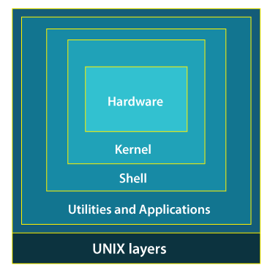
Structure of Unix OS

Slide 23
Shell
The Shell is an interpreter that interprets the command submitted by the user at the terminal, and calls the program you simply want.
It also keeps a history of the list of the commands you have typed in. If you need to repeat a command you typed it, use the cursor keys to scroll up and down the list or type history for a list of previous commands. There are various commands like cat, mv, cat, grep, id, wc, and many more.

Slide 24
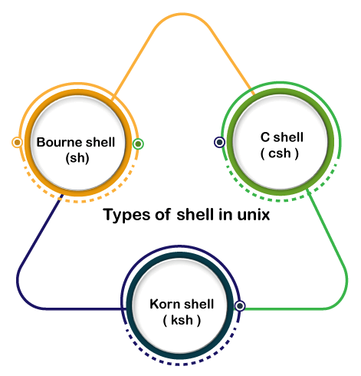

Slide 25
Types of Shell in UNIX
Bourne Shell: This Shell is simply called the Shell. It was the first Shell for UNIX OS. It is still the most widely available Shell on a UNIX system.
C Shell: The C shell is another popular shell commonly available on a UNIX system. The C shell was developed by the University of California at Berkeley and removed some of the shortcomings of the Bourne shell.
Korn Shell: This Shell was created by David Korn to address the Bourne Shell's user-interaction issues and to deal with the shortcomings of the C shell's scripting quirks.
Notes:
Application programs For Example: emacs editor, StarOffice, xv image viewer, g++ compiler etc.

Slide 26
Linux OS
The Linux OS was developed by Linus Torvalds in 1991, which sprouted as an idea to improve the UNIX OS. He suggested improvements but was rejected by UNIX designers. Therefore, he thought of launching an OS, designed in a way that could be modified by its users.
Nowadays, Linux is the fastest-growing OS. It is used from phones to supercomputers by almost all major hardware devices.

Slide 27
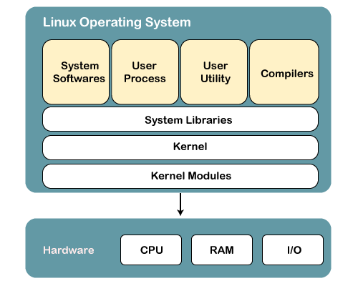

Slide 28
Structure of Linux OS
Kernel: Linux kernel is the core part of the operating system. It establishes communication between devices and software. Moreover, it manages system resources.
2) System Libraries
System libraries are special programs that help in accessing the kernel's features. A kernel has to be triggered to perform a task, and this triggering is done by the applications. But applications must know how to place a system call because each kernel has a different set of system calls. Programmers have developed a standard library of procedures to communicate with the kernel. Each operating system supports these standards, and then these are transferred to system calls for that operating system.
The most well-known system library for Linux is Glibc (GNU C library).

Slide 29
Structure of Linux OS
The most well-known system library for Linux is Glibc (GNU C library).
3) System Tools
Linux OS has a set of utility tools, which are usually simple commands. It is a software which GNU project has written and publish under their open source license so that software is freely available to everyone.
With the help of commands, you can access your files, edit and manipulate data in your directories or files, change the location of files, or anything.

Slide 30
Structure of OS
4) Development Tools
With the above three components, your OS is running and working. But to update your system, you have additional tools and libraries. These additional tools and libraries are written by the programmers and are called toolchain. A toolchain is a vital development tool used by the developers to produce a working application.
5) End User Tools
These end tools make a system unique for a user. End tools are not required for the operating system but are necessary for a user.
Some examples of end tools are graphic design tools, office suites, browsers, multimedia players, etc.

Slide 31
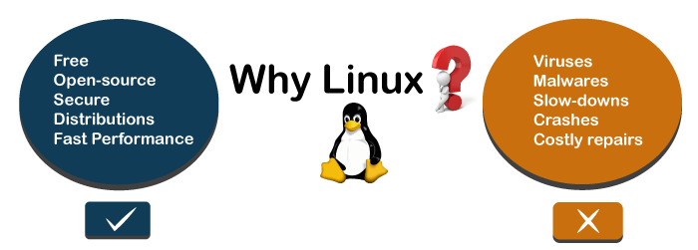

Slide 32
Any Query???

